Slide 1
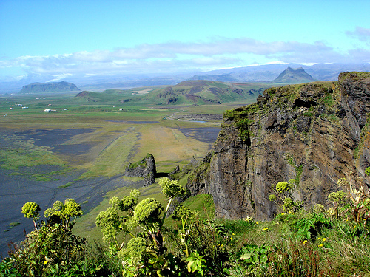
Landforms

Slide 2
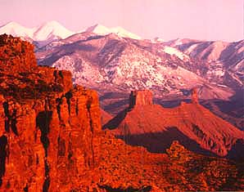
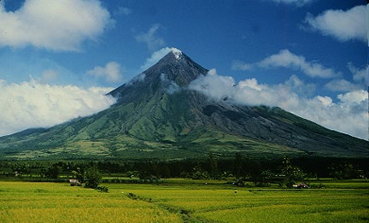
Landform
Landforms are the natural shapes or features of land.

Slide 3
Types of Landforms
1. Mountain
2. Hills
3. Valley
4. Plain
5. Plateau
6. Peninsula
7. Isthmus
8. Island

Slide 4
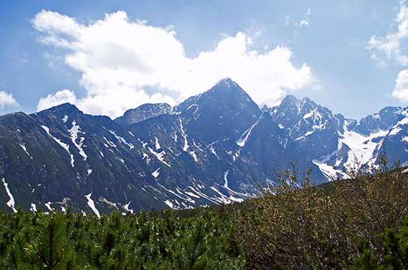
Mountain
A mountain is a place on Earth’s surface that is much higher than the land around it.

Slide 5
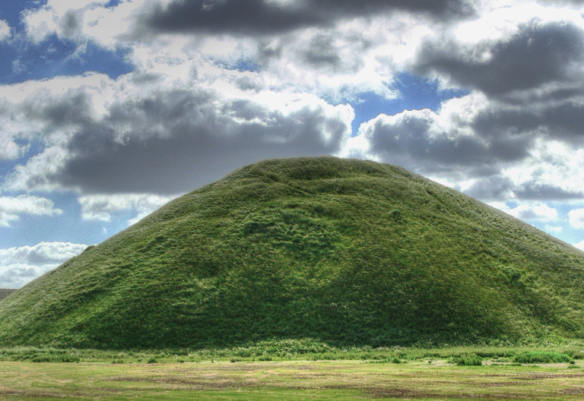
Hill
A hill is a raised area or mound of land

Slide 6
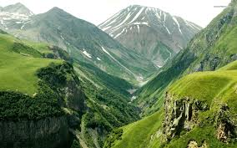
Valley
A valley is a lowland area between higher lands such as mountains. Some valleys have a river or stream flowing through them!

Slide 7
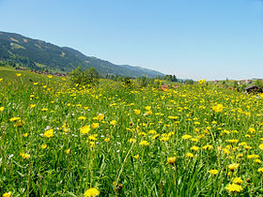
Plain
A plain is a flat area with few trees.

Slide 8
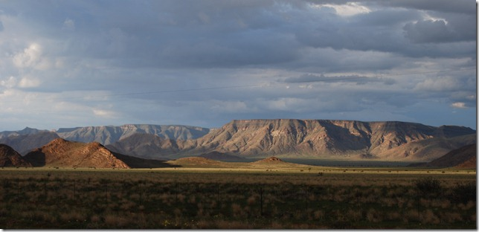
Plateau
A plateau is a flat area higher than the land around it. This looks like a mountain with no peak!

Slide 9
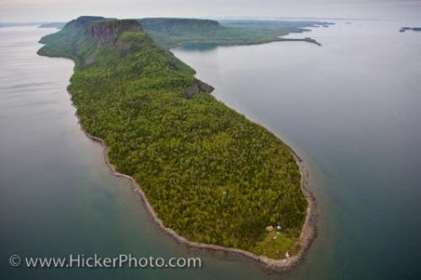
Peninsula
A peninsula is a body of land that is connected to a mainland and surrounded by water on three sides.

Slide 10
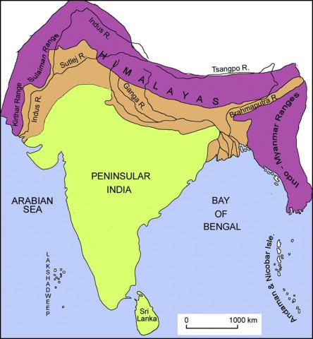

The southern part of India is a peninsula as it is surrounded by the Arabian sea, Bay of Bengal and the Indian ocean and is joined to land on the fourth side.

Slide 11
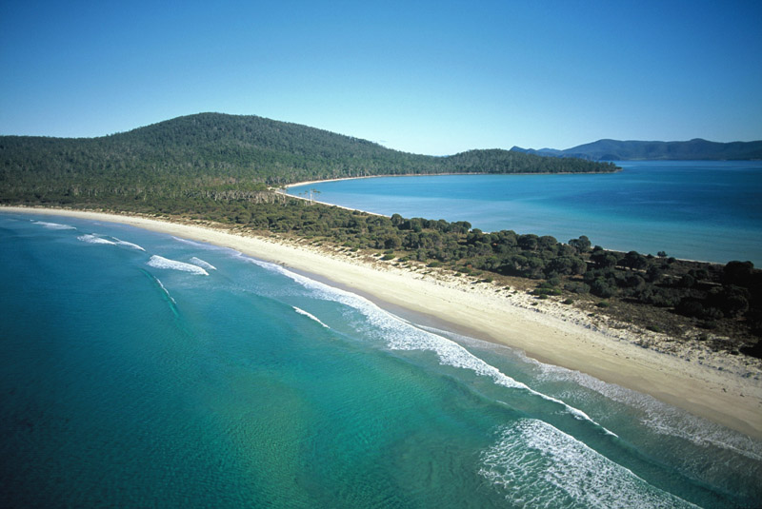
Isthmus
An isthmus is a narrow strip of land that connects two larger areas of land, usually with water on both sides!

Slide 12
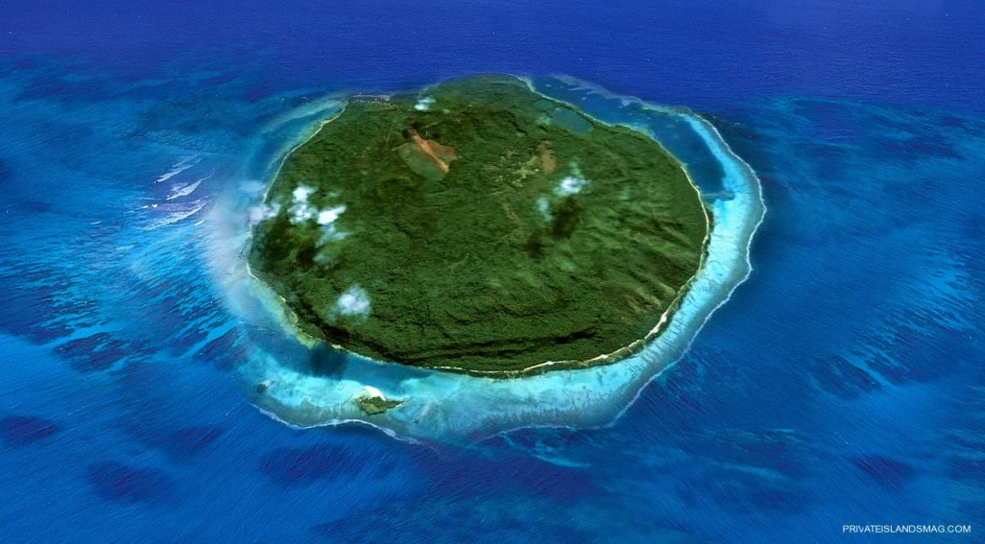
Island
An island is land that is completely surrounded by water.

Slide 13
Quiz

Slide 14
Lowland area between mountains are called as __________
Valley
Island
hill
Hint

Slide 15
Narrow strip of land that connects two large areas of land
Isthmus
Plain
Island
Hint

Slide 16
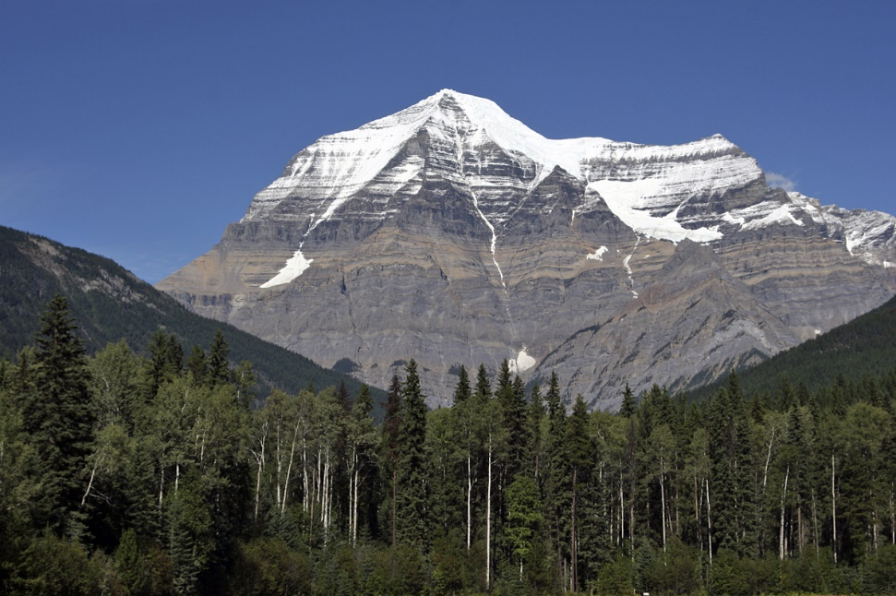
A _______ is higher than the land around it.
Island
Mountain
Valley
Hint

Slide 17
Land covered with three sides of water
Plateau
Hill
Peninsula
Hint

Slide 18
I am land and have water all around me. What am I?
Island
Coast
Desert
Hint

Slide 19
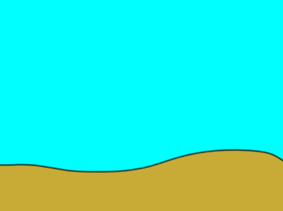
Name the landform:
Plain

Slide 20

Name the landform:
Mountain

Slide 21
Name the landform:
Hill

Slide 22
Name the landform:
Valley

Slide 23
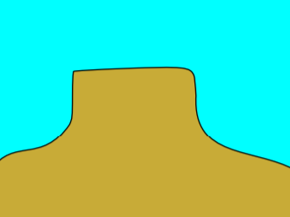
Name the landform:
Plateau

Slide 24
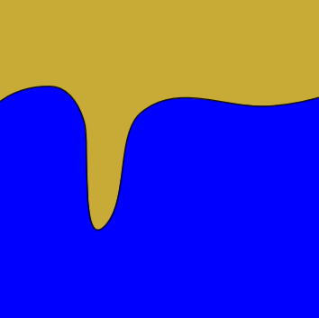
Name the landform:
Peninsula

Slide 25
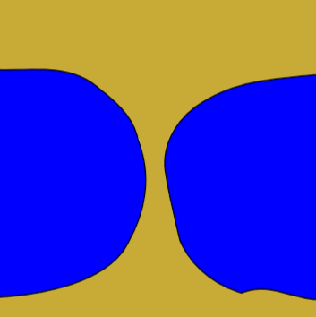
Name the landform:
Isthmus

Slide 26
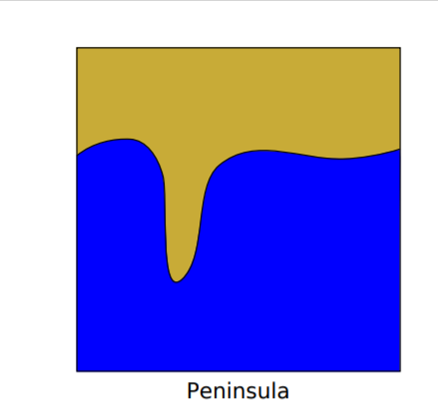

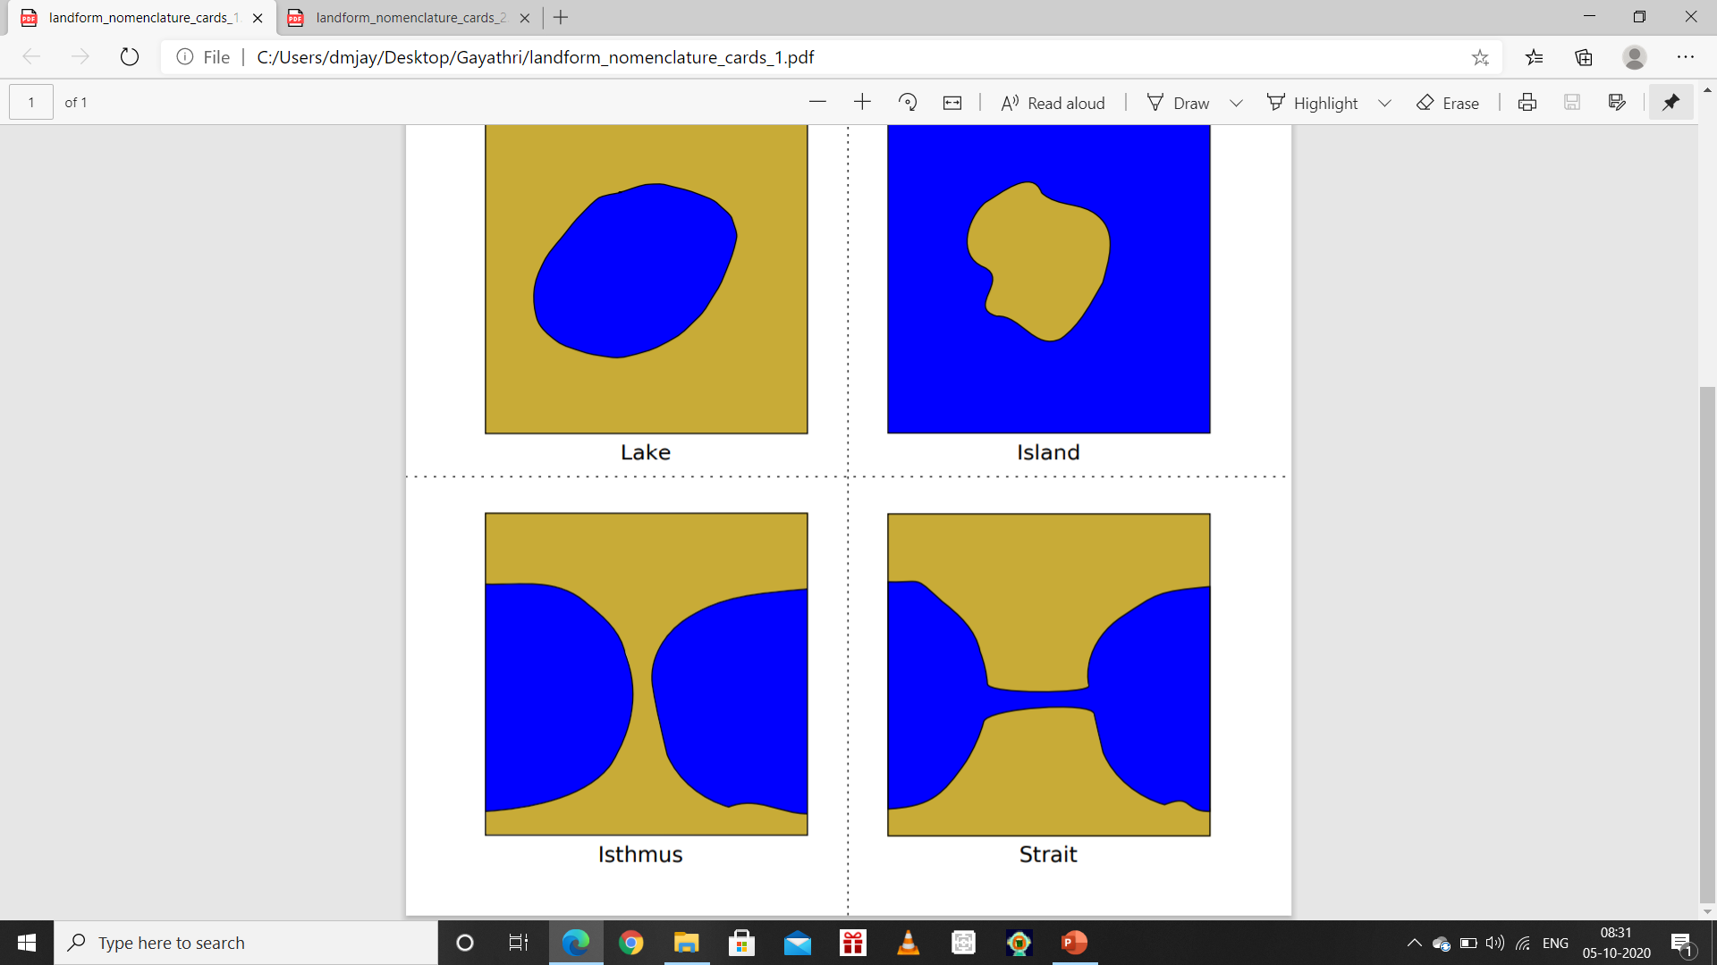
Homework
Draw these landforms. Colour and name the landforms

